Slide 1
Paperly – Research Assistant
MSA8700 – Gen AI Solutions
Team Members
Mahitha Borra
Pancham Desai
Ruudra Patel
April 28, 2025

Slide 2
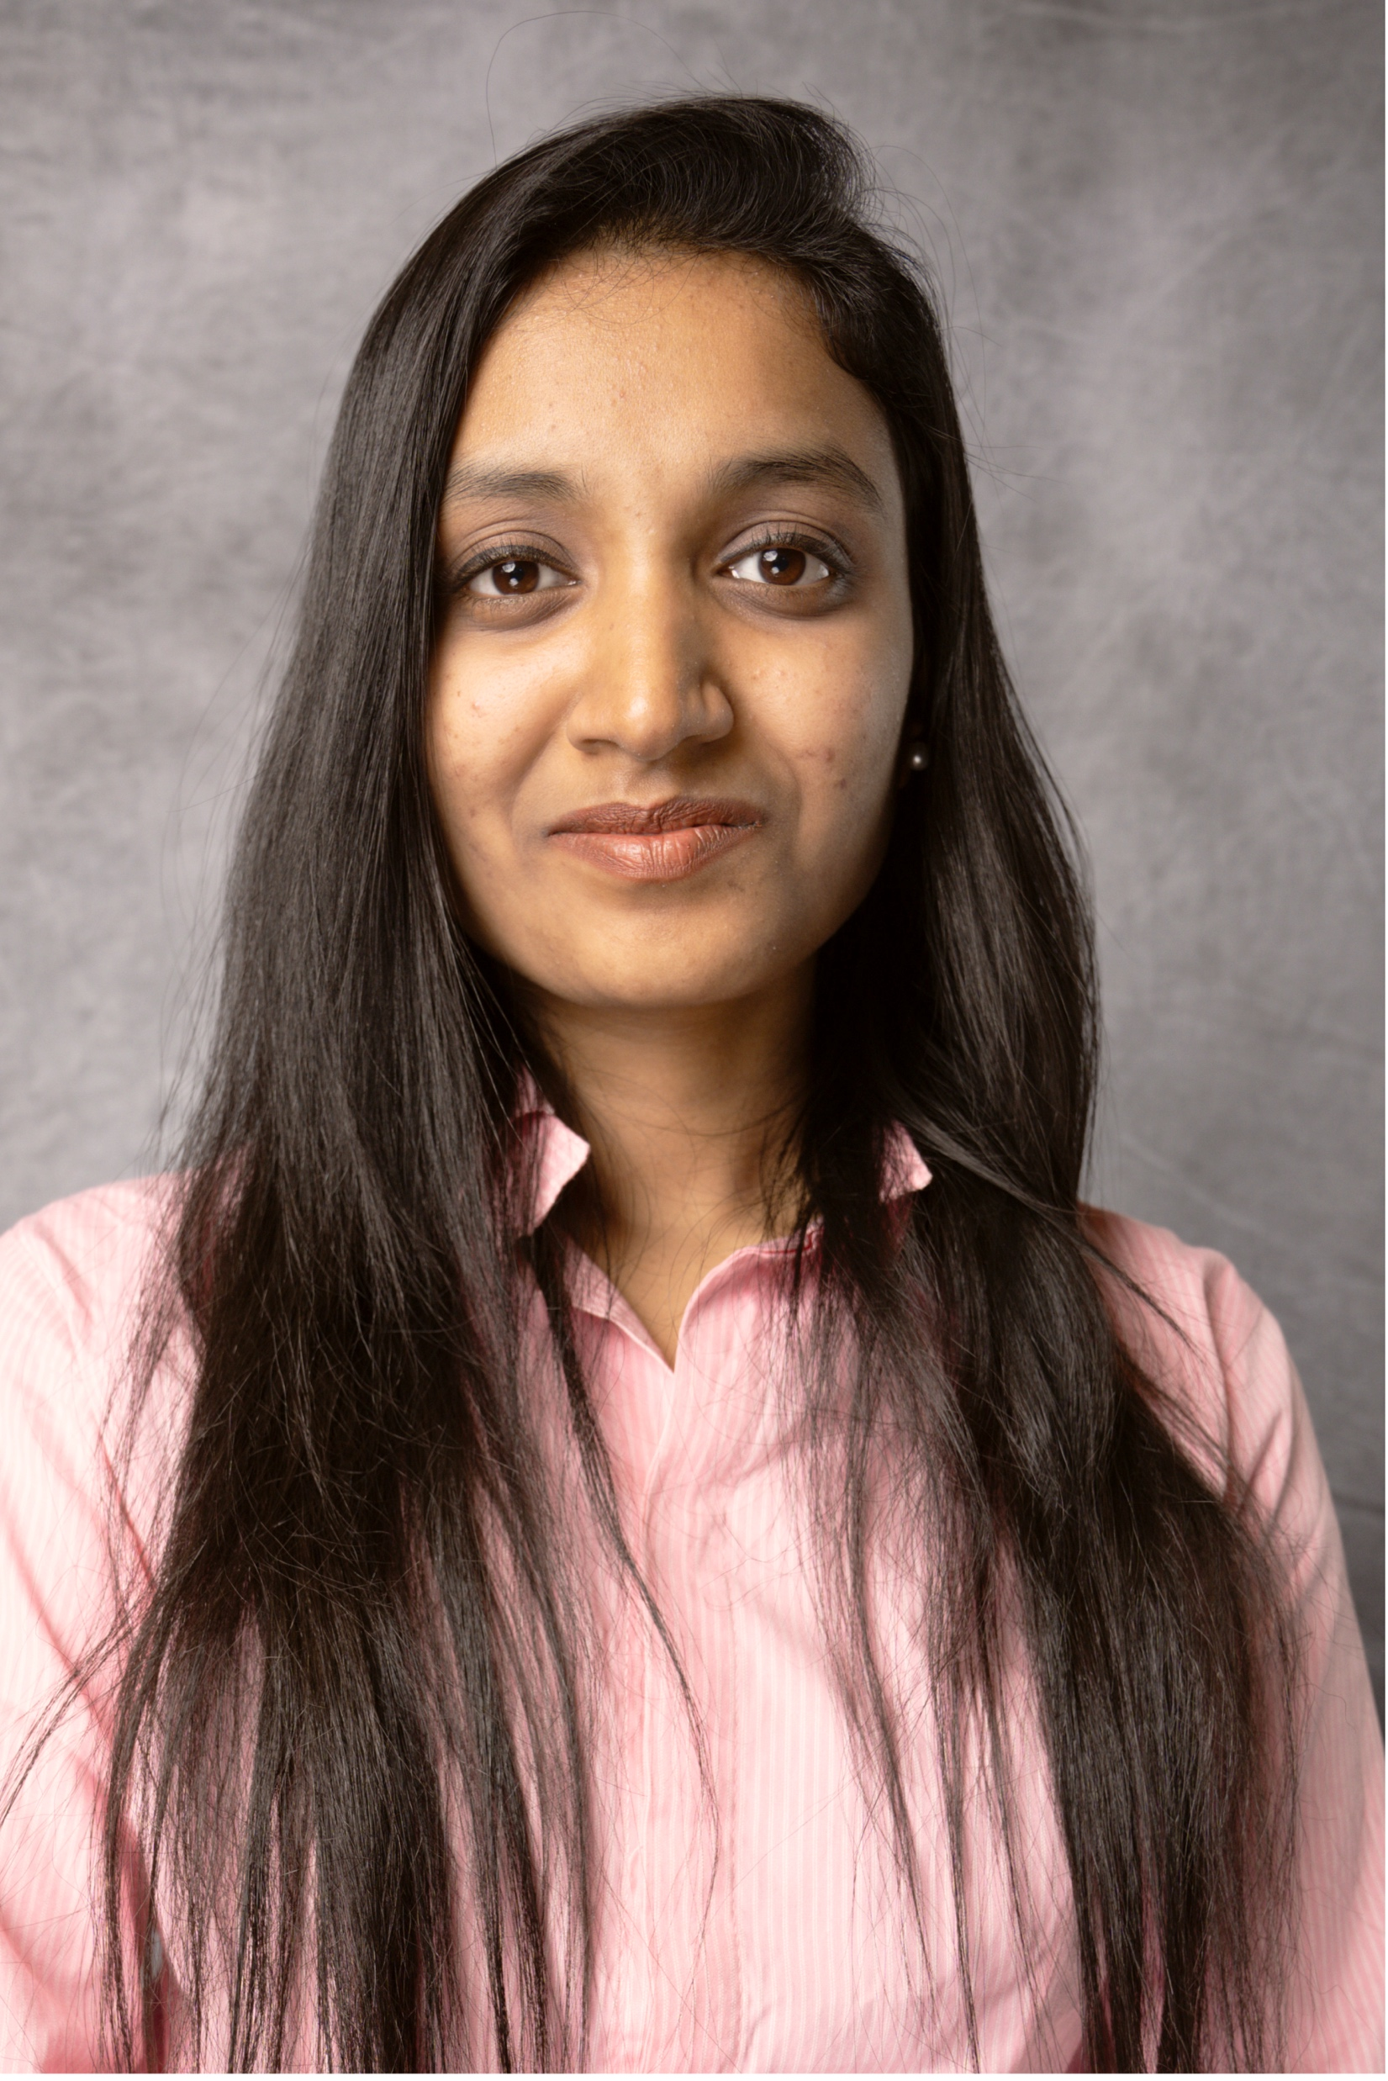
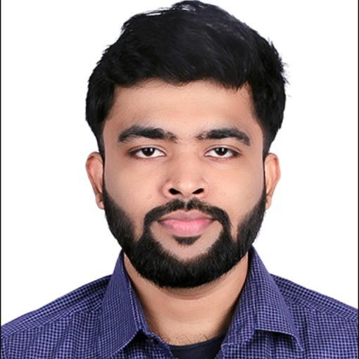
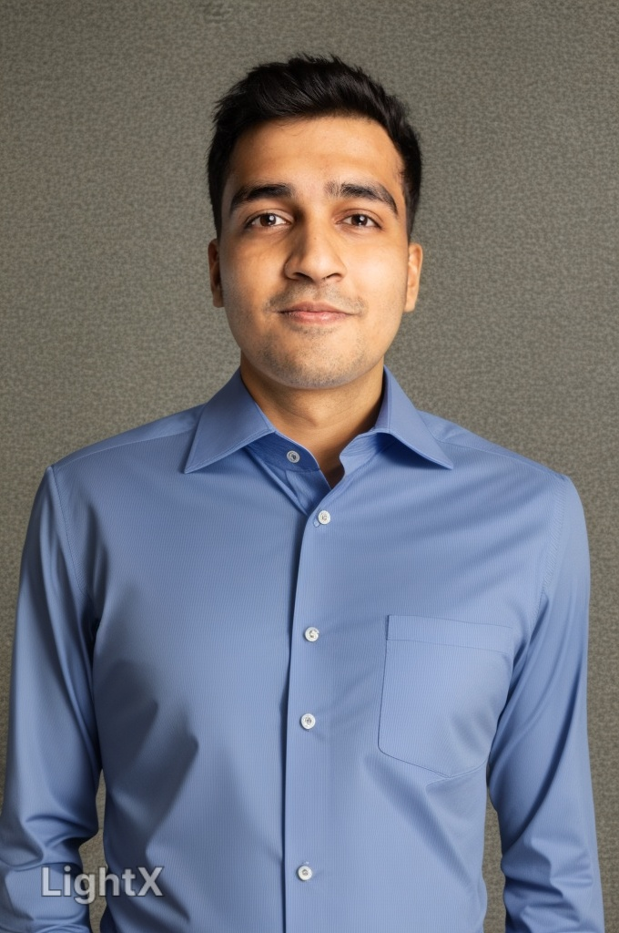
Team Members
Mahitha Borra
PanchamDesai
Ruudra Patel

Slide 3
Pitch

Slide 4


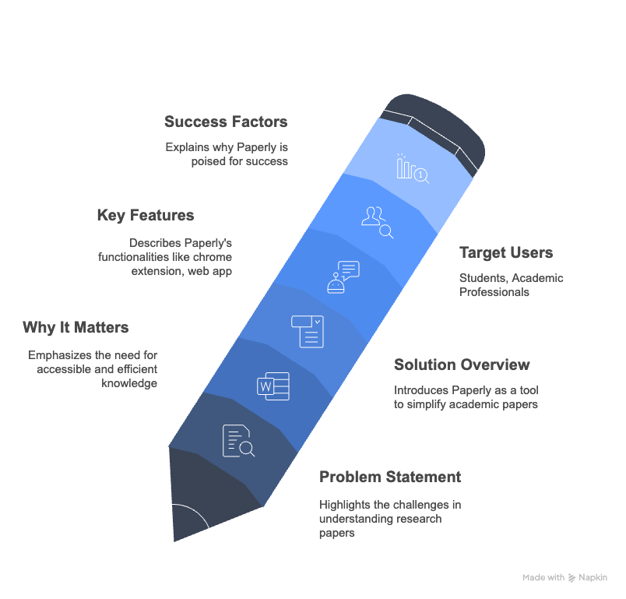
Paperly – AI Powered Research Paper Assistant
Research papers are complex, and time-consuming to understand. Students, and professionals struggle with:
Quickly grasping key findings.
Understanding domain-specific language.
AI-powered assistant to simplify reading academic papers. Provides:
Concise Summaries
Contextual Q&A
Immediate Explanations
Paper Recommendations

Slide 5
Tech Stack

Slide 6












Tools and technologies
Chrome Extension
(Front end)
Chrome Extension
(Back end)
Web Application

Slide 7
Team Structure

Slide 8
Team Structure
Pancham Desai (Project Manager, AI Developer)
Led end-to-end project execution, overseeing system design, development, and deployment timelines.
Implemented a Research Paper Q&A system using Retrieval-Augmented Generation (RAG) techniques with Groq API.
Collaborated closely with Mahitha to integrate the Q&A system into a Chrome Extension for seamless user interaction
Managed user feedback cycles and iteratively refined system functionalities based on real-world testing.
Ruudra Patel (Frontend Developer, AI Integrations Engineer)
Explored and reviewed various LLM integration APIs to power summarization capabilities.
Developed the Summarization Module to automatically extract key insights from research papers.
Designed and deployed the full Website UI using streamlit for Paperly ensuring a seamless and intuitive user experience.
Performed user testing sessions and continuously improved the UI/UX based on iterative feedback.
Mahitha Borra (Full stack Gen AI Engineer, QA Tester)
Built the Chrome Extension using HTML and Javascript frameworks to build the product.
Integrated an Agent along with Pancham using langchain into the Research Paper Q&A system
Designed and developed a responsive and intuitive Chrome Extension UI tailored for research summarization, QnA and Recommendation
Collaboration framework
Weekly meetings every Friday at 2 PM via Zoom.
Integration checkpoints every Wednesday.
Regular syncs with and testing.
Team consensus for major decisions
Pancham as final decision-maker.
Documentation via README files in Github.

Slide 9
Demo Screenshots

Slide 10
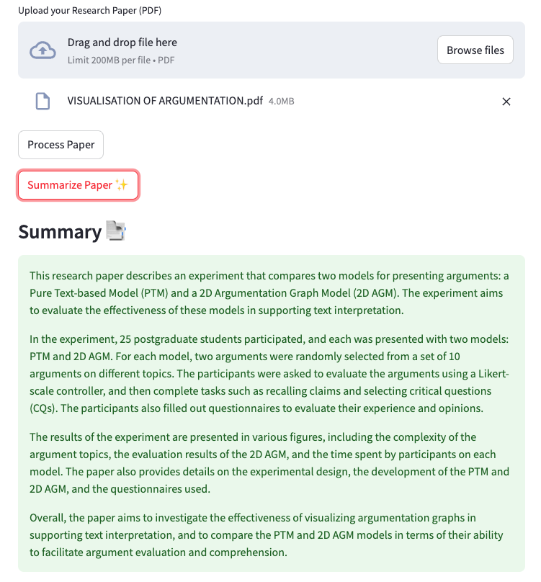
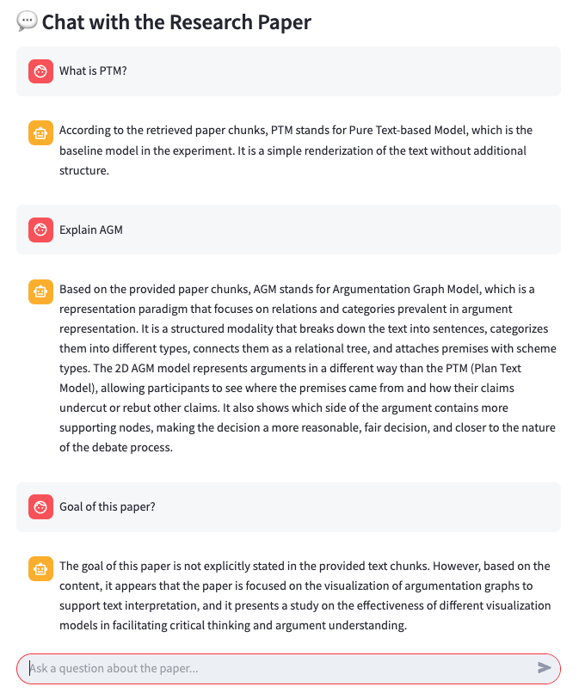
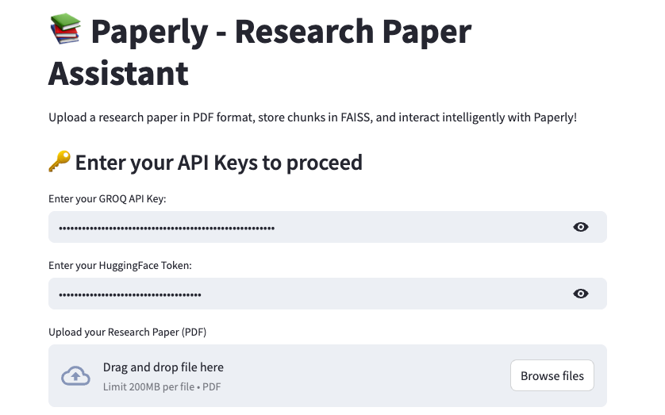
Paperly – Web Interface
Upload Research Paper in PDF format
Chunks the PDF
Summarizes the PDF
Enter Your Groq API and Hugging Face token
Ask Questions about the paper you uploaded

Slide 11
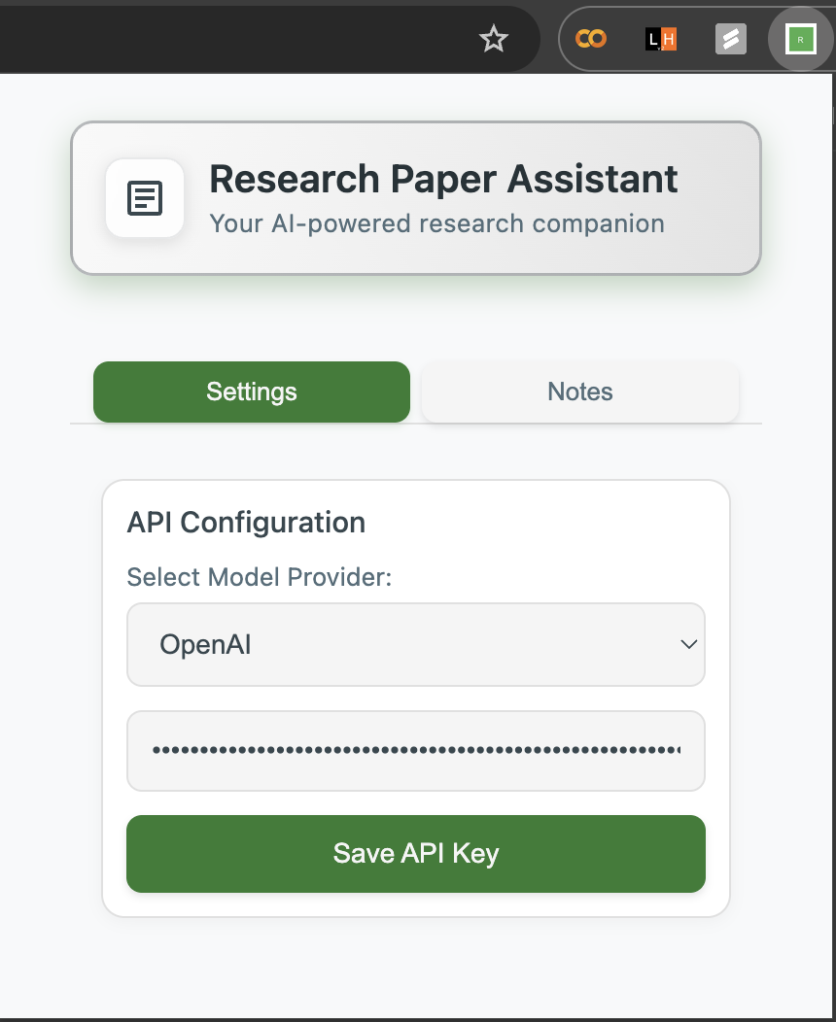
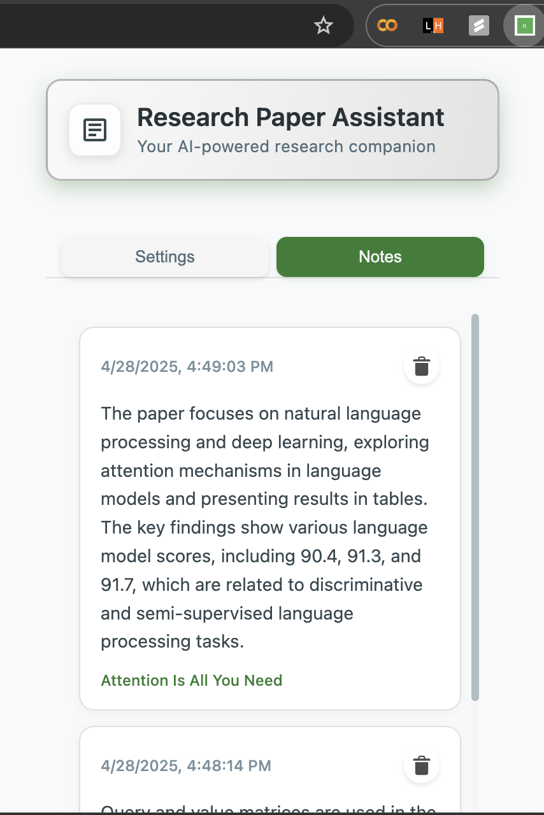
Paperly – Chrome Extension
Select your Model Provider and then add the API Key
Bookmark answers

Slide 12
Paperly – Chrome Extension
Select your Model Provider and then add the API Key
Bookmark answers

Slide 13
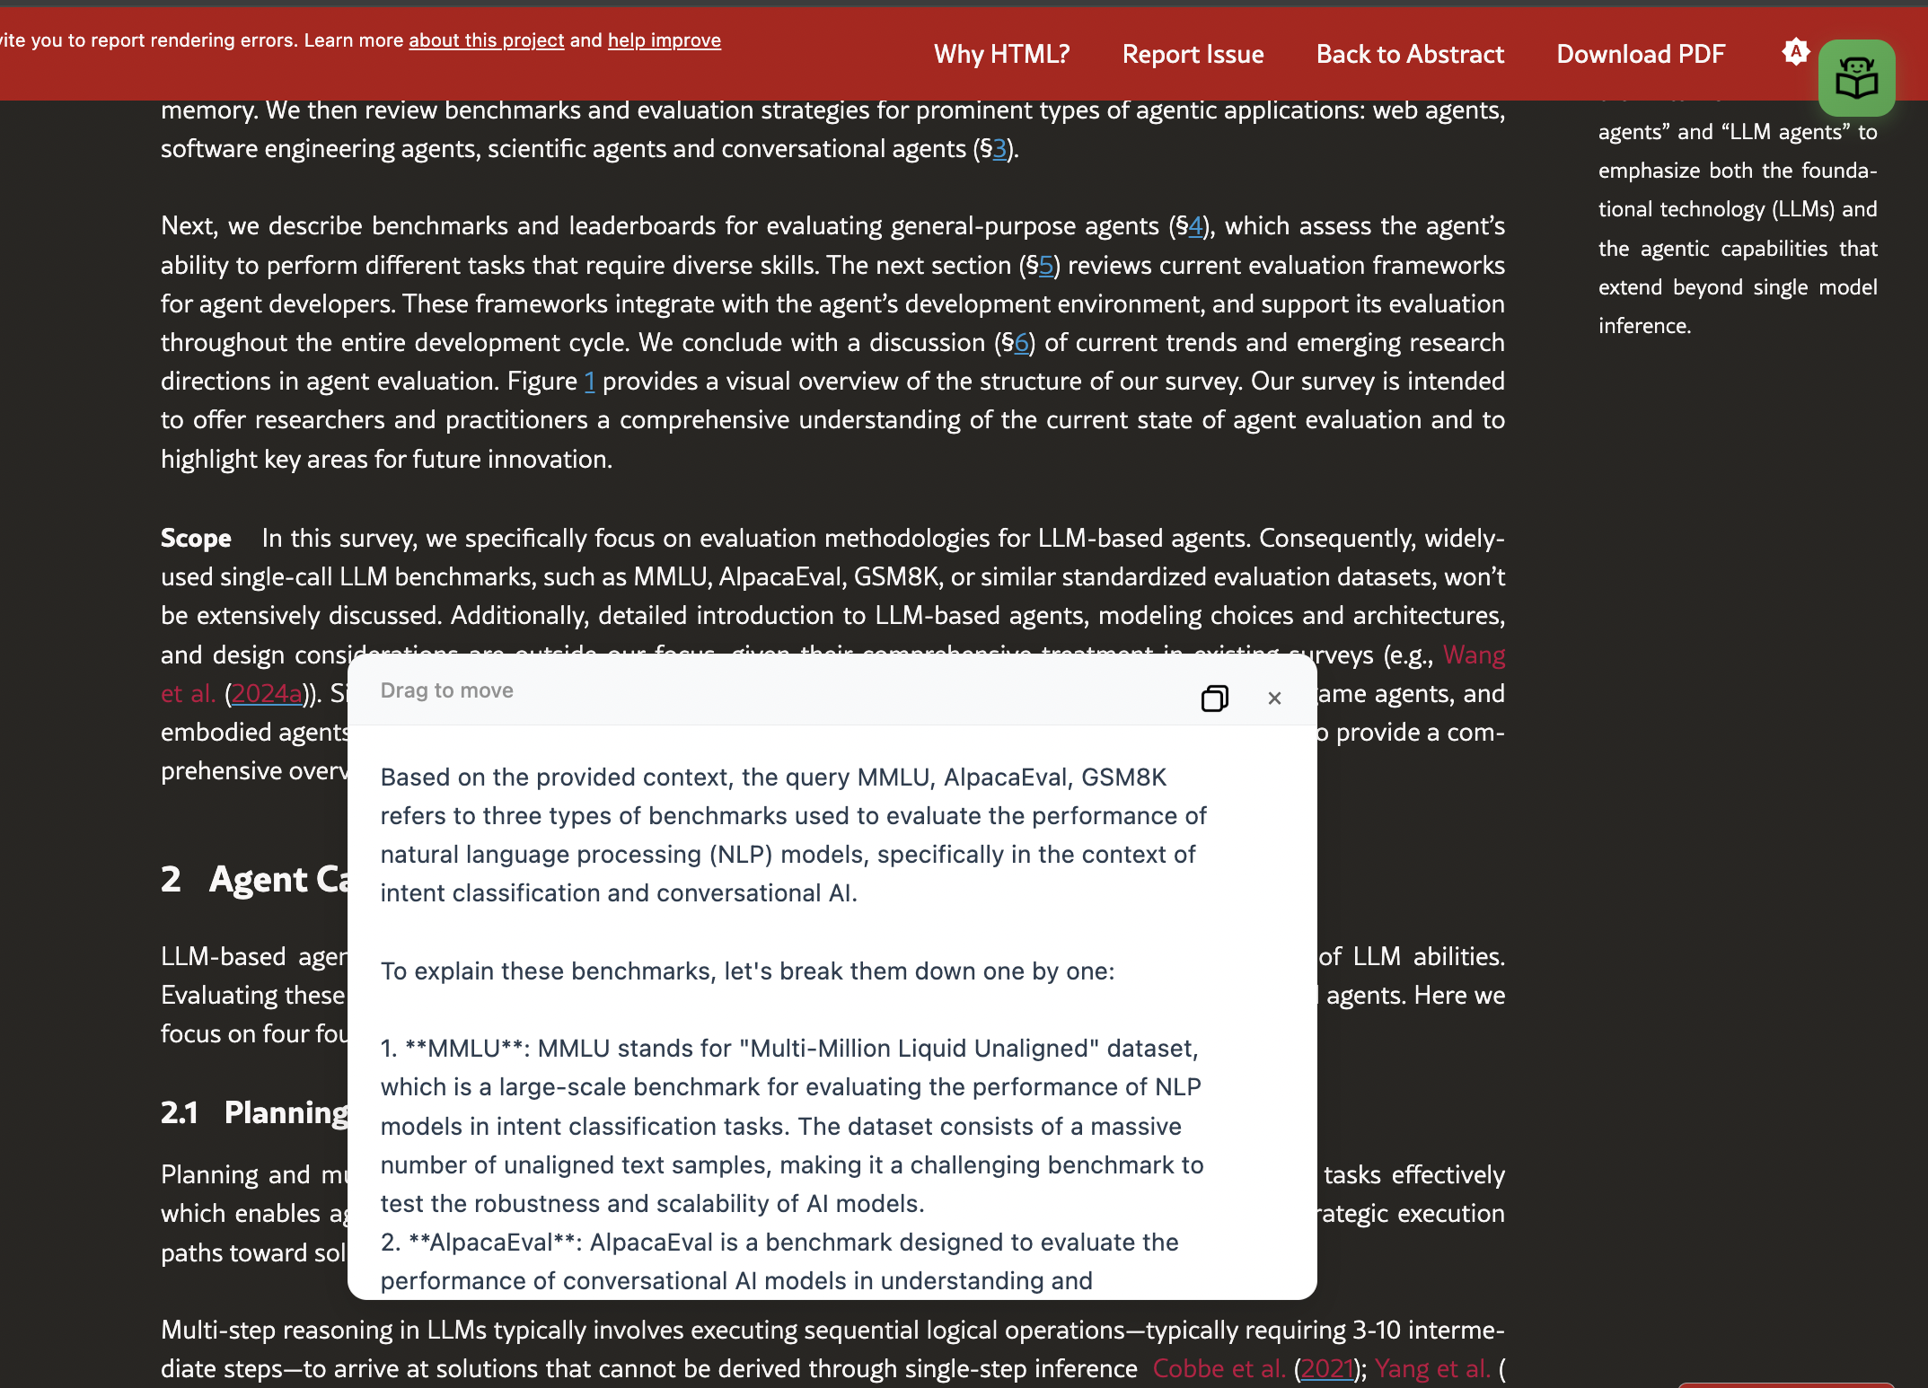
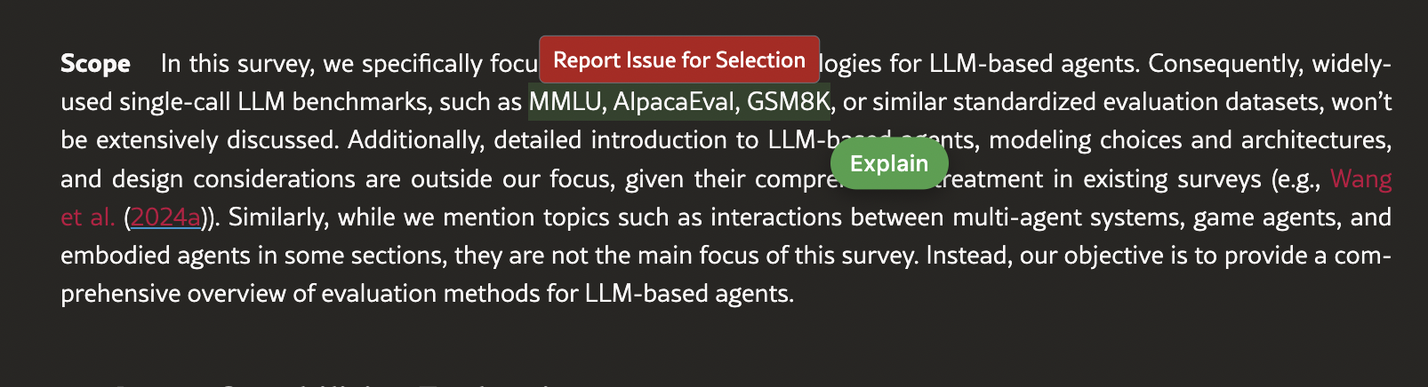
Paperly – Chrome Extension
Select the text you want to explanation for
AI Generated explanation of selected text

Slide 14
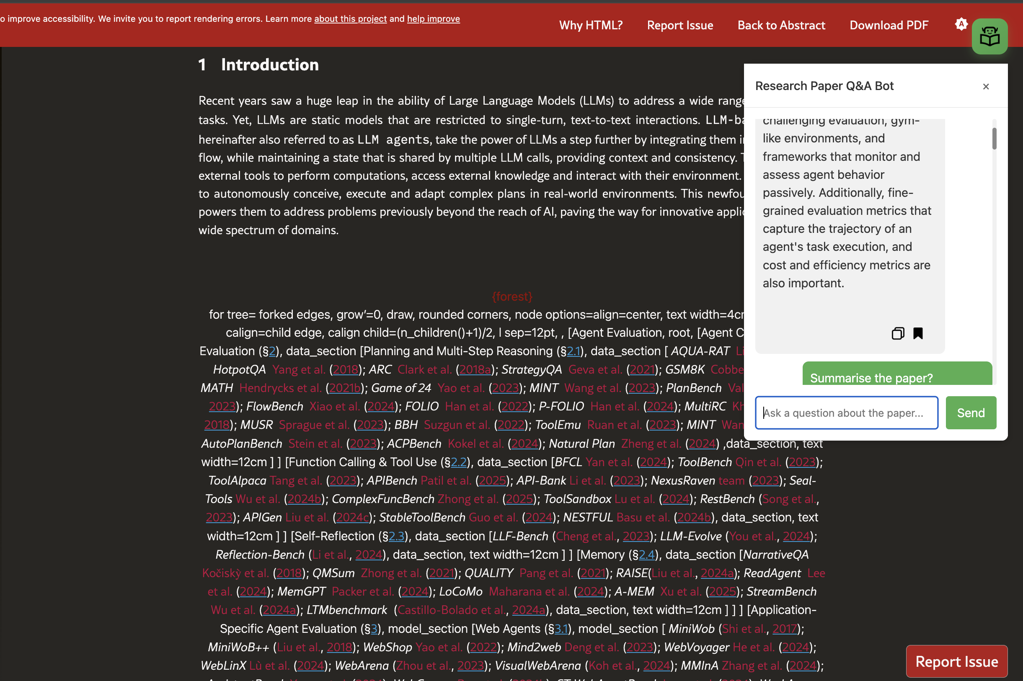
Paperly – Chrome Extension
Chrome Extension for Q&A Bot: Instantly chat with an AI agent to get answers to research paper queries.

Slide 15
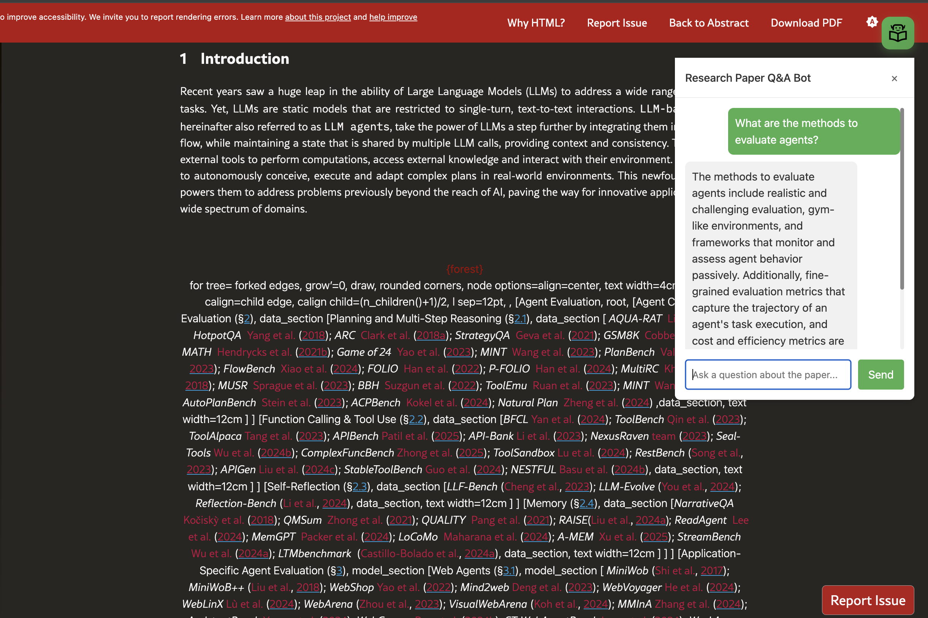
Paperly – Chrome Extension
AI Agent answering to user queries

Slide 16
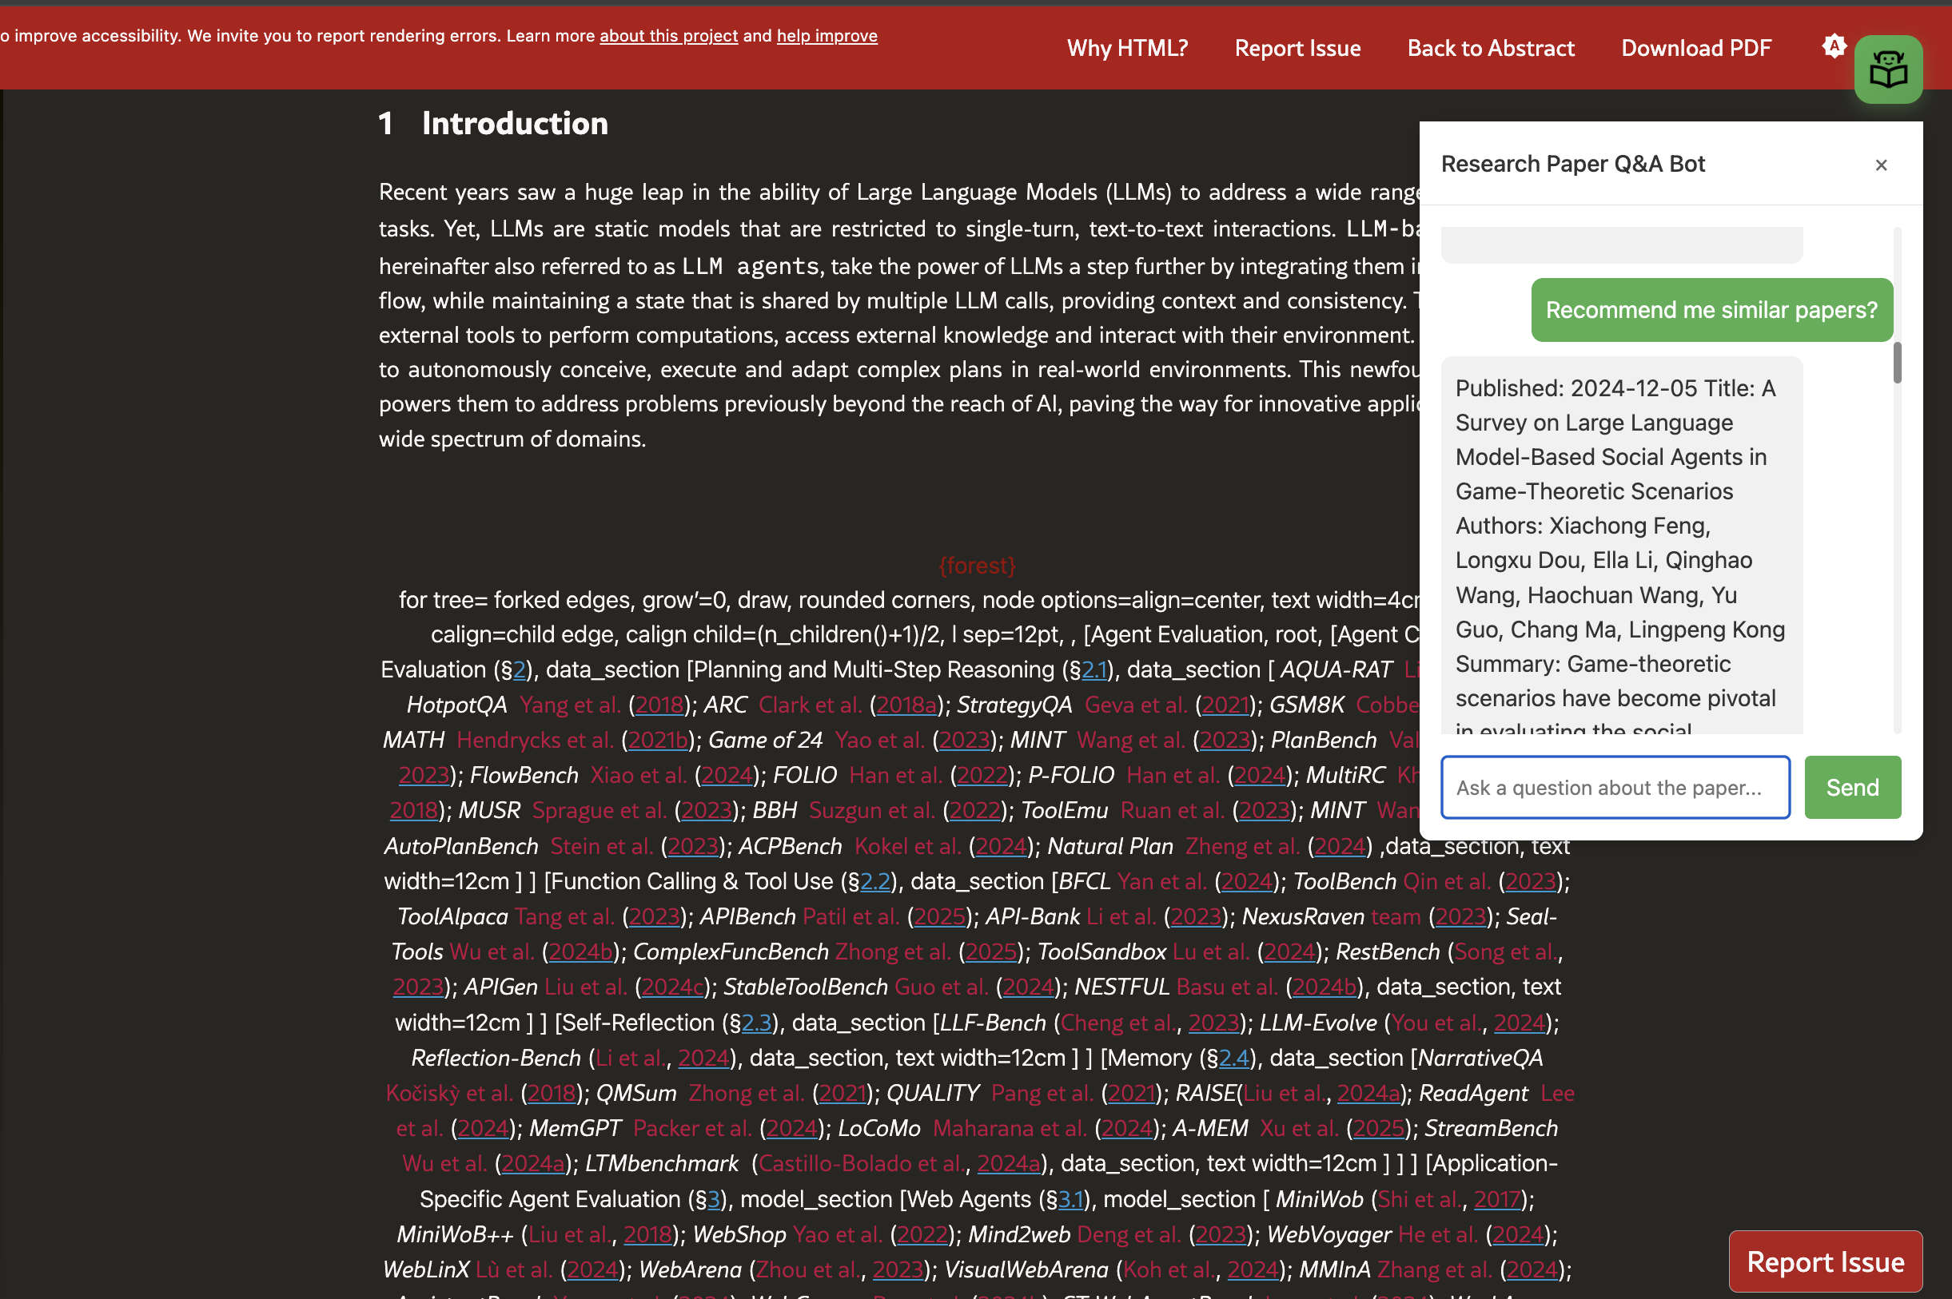
Paperly – Chrome Extension
AI Agent recommending papers

Slide 17
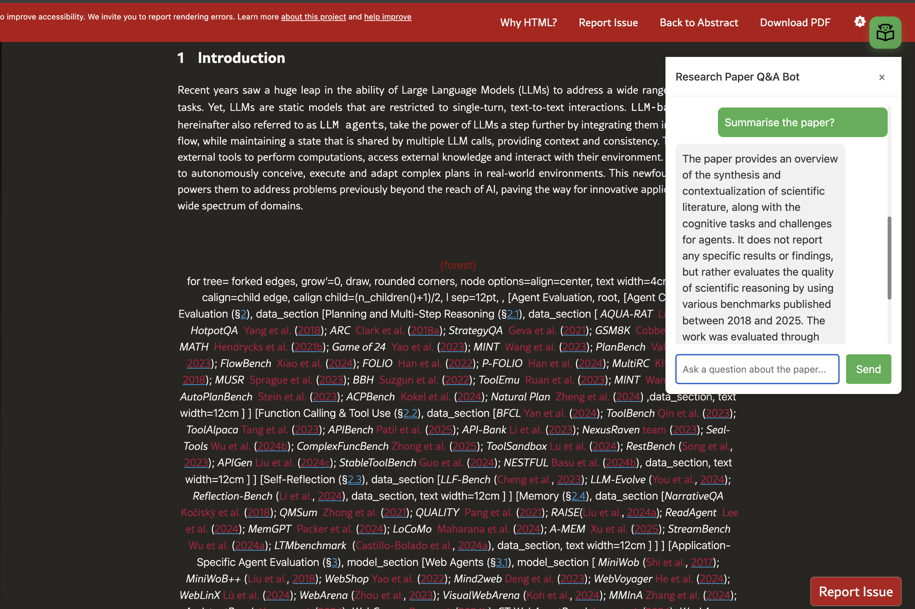
Paperly – Chrome Extension

Slide 18
Thank you

